Slide 1
COVID - 19 Statistics
Nishika Abeytunge, Gabrielle Catania,
Jordan Solorio, Darren Sagucio

Slide 2
Motivation & Summary Slide
Our project aims to examine the impact of COVID-19 across America. Our inquiry includes:
Finding average mortality rates, total cases, and other aggregate measures
Determining the effect COVID-19 has had on unemployment
Identifing any correlation between age/sex and and incidence or severity of COVID-19
Identifying disparities in the impact of COVID across different racial demographics
Notes:
(Jordan?) Presentation Requirement - Describe the core message or hypothesis for your project.

Slide 3
Motivation & Summary (cont.)
Which areas/regions in the U.S were affected by the virus the most/least?
Are there any correlations between the rising number of Covid-19 cases and unemployment rates in the U.S.?
What other types of data could we extract from the web about Covid-19? Any information about case rates, deaths, hospitalization, ICUs, or ventilators?
How did Covid-19 impact various demographics such as: Gender, Age, and Ethnicity?
The reasons why we want to answer these questions... It’s a relevant topic and there are numerous datasets to choose from!
Were we satisfied? Yes!
Notes:
(Darren) Presentation Requirement - Describe the questions you and your group found interesting, and what motivated you to answer them
* Describe the questions you asked, and _why_ you asked them
* Describe whether you were able to answer these questions to your satisfaction, and briefly summarize your findings

Slide 4
Questions & Data
Utilizing the resources available - Google, Kaggle, Census Data, CDC Data - our goal is to view Covid19 statistics nationwide and analyze the results.
Through our analysis and data cleaning, we hope to see any correlations with the statistics such as:
The effects of Covid19 relative to region
The effects of Covid19 relative to unemployment rates
The effects of Covid19 relative to Age and Gender demographics
The effects of Covid19 relative to Ethnicity
Notes:
Presentation Requirement - Summarize where and how you found the data you used to answer these questions

Slide 5
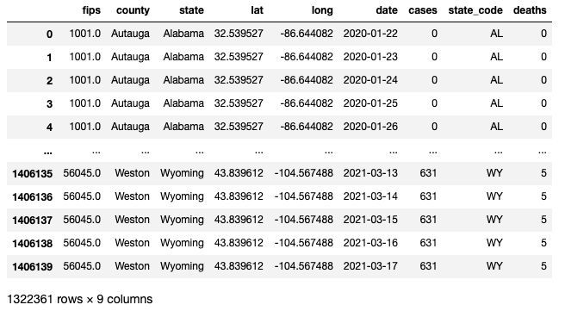

Data Cleanup & Exploration
Exploration:
Sifting through trustworthy datasets that were both sufficiently large and relevant to our topic
Trying out different APIs
Overcoming privacy restrictions
Cleanup:
‘NaN’ Rows: deleted or filled with zero
Found and deleted repeat data and/or extraneous information
Re-format datasets to accommodate for merge or graphing
Problems:
Census API…
No solution.
Datasets being so massive they almost broke our computers when we tried to download them
API calls (or finding new datasets)
Notes:
Presentation Requirement - Describe the data exploration and cleanup process (accompanied by your Jupyter Notebook)

Slide 6
Data Analysis
Mission in Mind
Possible correlation of the available fields to make the best story
Going beyond the basics
Using demographics Census Data to normalize the covid related data
U.S Bureau of Statistics to analyze unemployment dataset
Tools came in handy
API calls, CSV reads, google maps, Functions, loops, graphs, Python, Matplotlib, Pandas, Numpy, Sodapy, Scipy
Notes:
Presentation Requirements
- Describe the analysis process (accompanied by your Jupyter Notebook)
- Tell a good story! Storytelling through data analysis is no different than in literature. Find your narrative and use your analysis and visualization skills to highlight conflict and resolution in your data

Slide 7
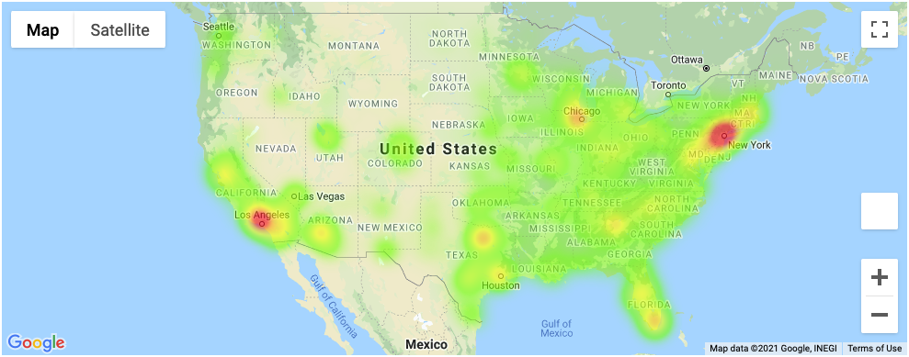
Covid Cases Heat Map (As of March 17, 2021)

Slide 8
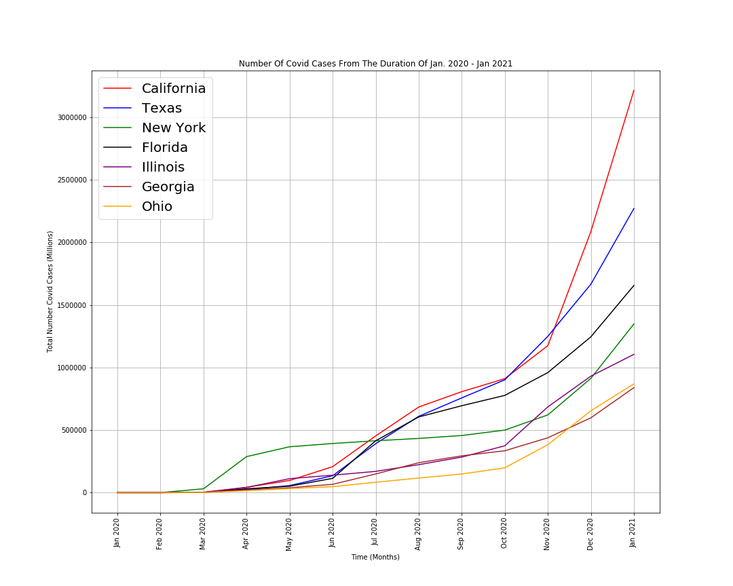
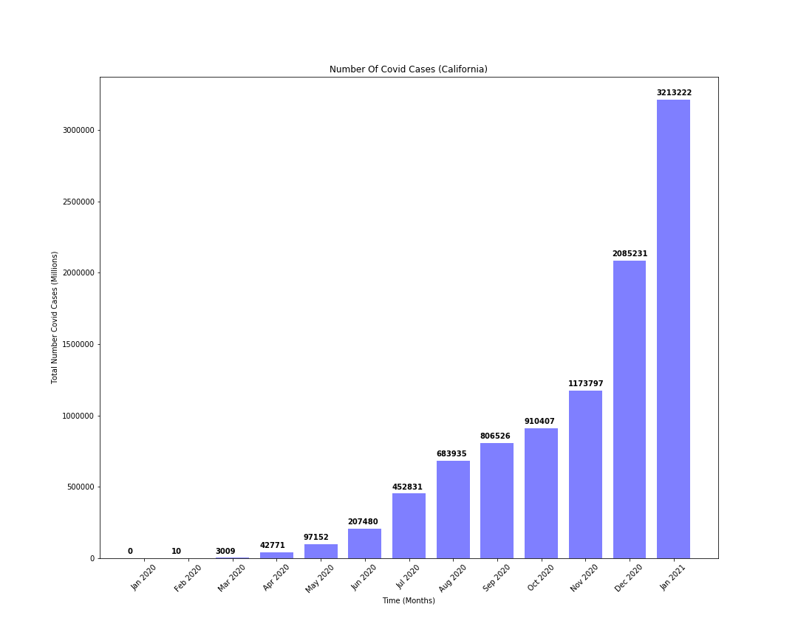

Slide 9
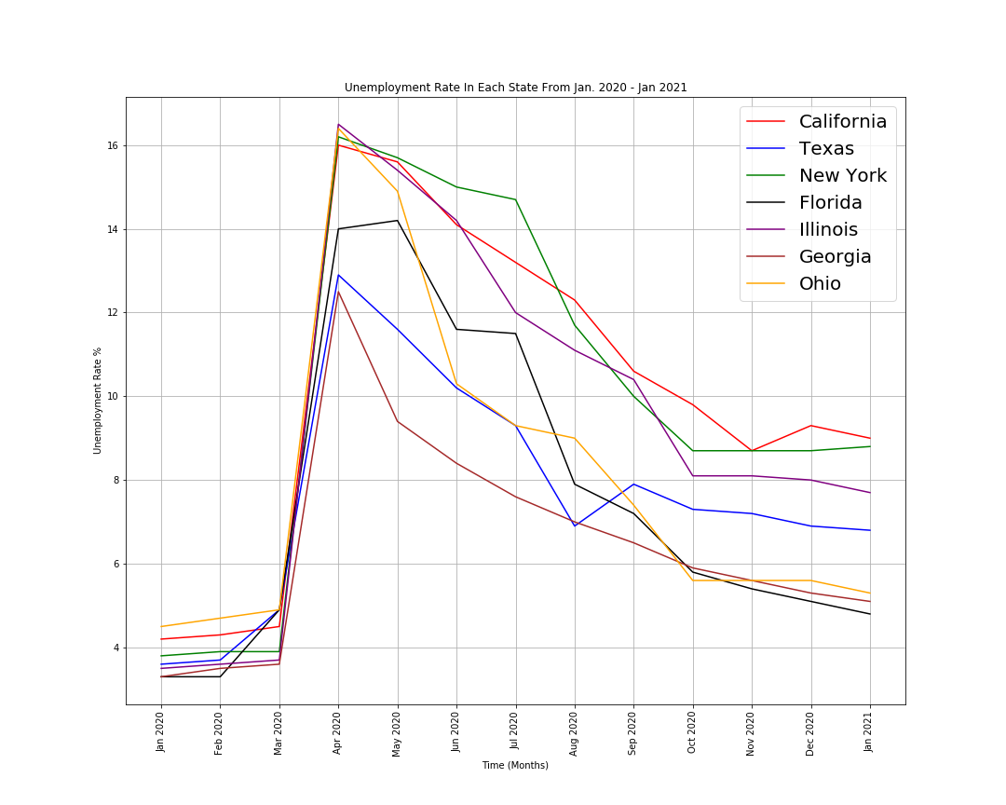
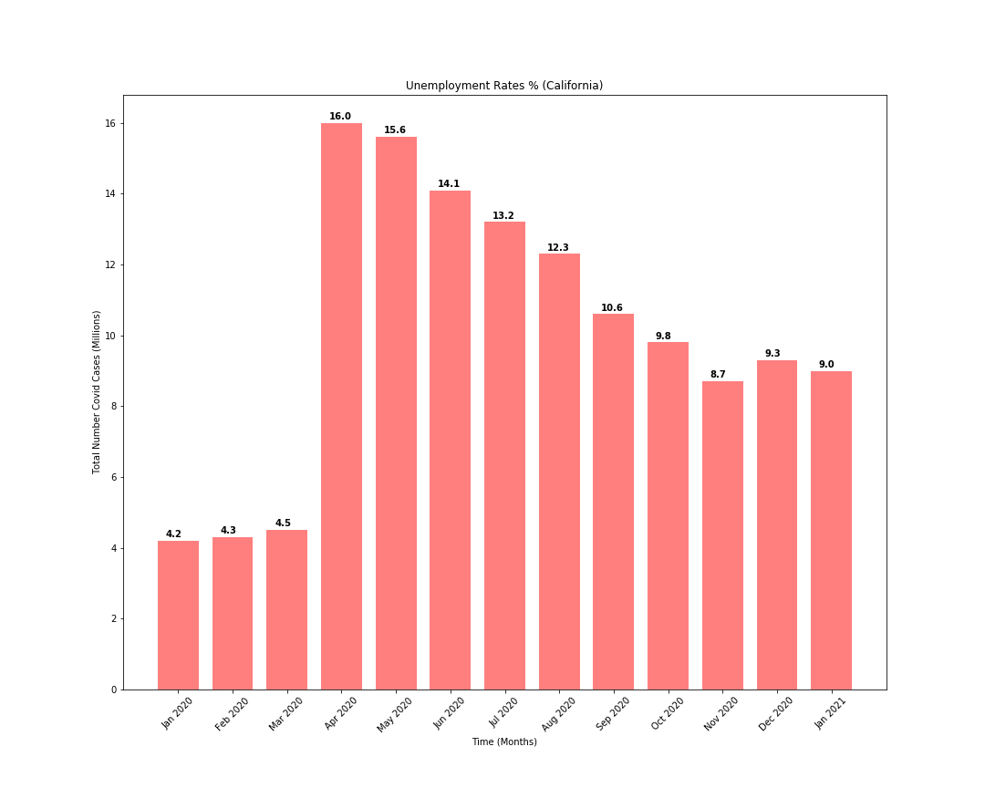

Slide 10

Conclusion?
Notes:
Summarize your conclusions. This should include a numerical summary (i.e., what data did your analysis yield),
as well as visualizations of that summary (plots of the final analysis data)
- Discuss the implications of your findings. This is where you get to have an open-ended discussion about what your findings "mean"
* Discuss any difficulties that arose, and how you dealt with them
* Discuss any additional questions that came up, but which you didn't have time to answer:
What would you research next, if you had two more weeks?

Slide 11
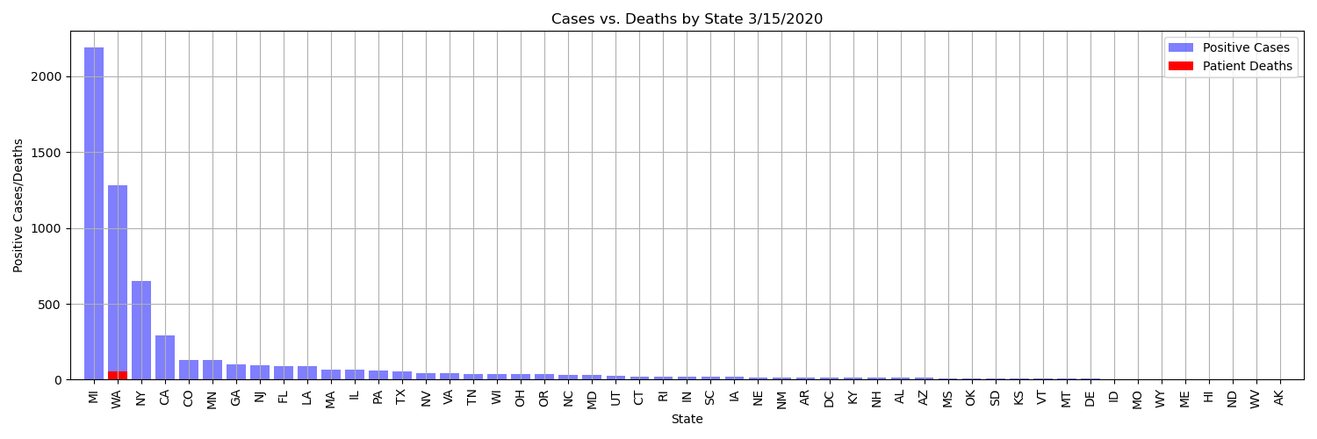
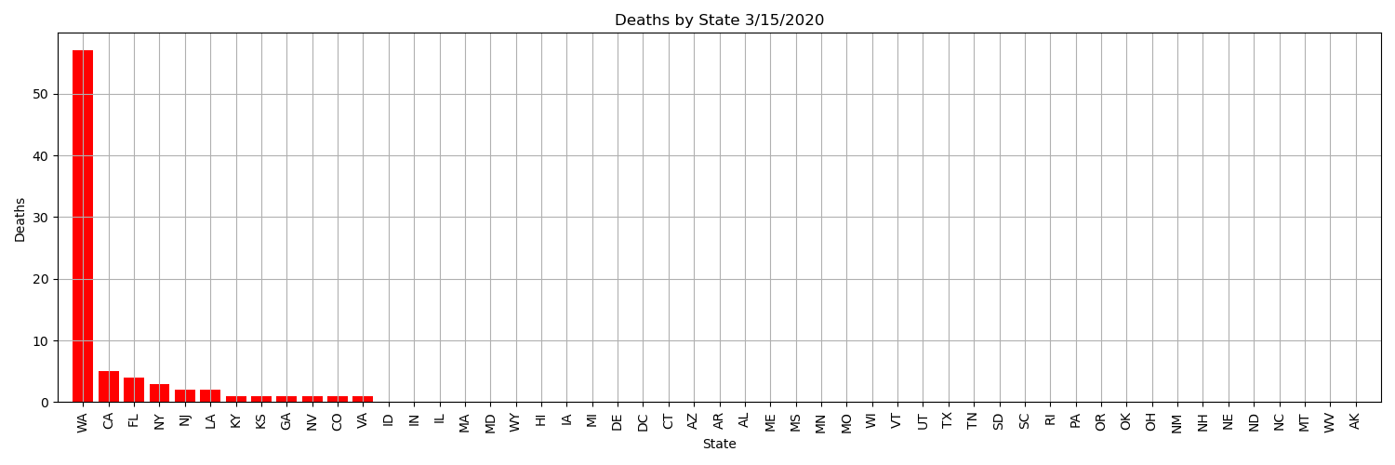
Notes:
March 15, 2020 cases and cumulative deaths per state.
WA deaths were high, and we know from available news nursing homes were hit the hardest in this state (does it reflect the age demographics?).
Deaths elsewhere still relatively low.

Slide 12
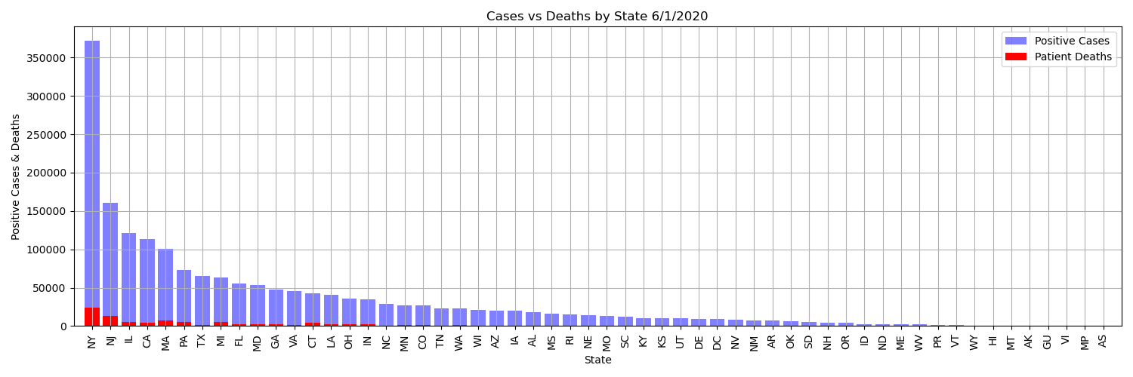
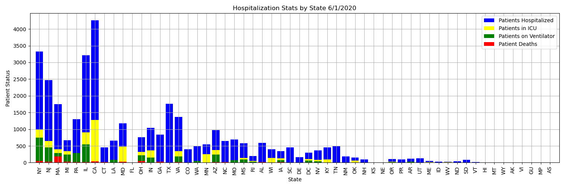
Notes:
Jump to June, post initial spike and plateau.
NY still in the lead. IL, CA, TX, FL, GA, OH still in top 1/3rd in terms of total cases and total deaths
When looking at hospitalization statuses, CA tho is in the lead in terms of hospitalizations and ICU patients, with NY in second, followed by IL. TX, GA, OH, are still low in comparison, FL is nonexistent, largely due to lack of available data. Same with GA and TX when it comes to anything other than hospitalization rates.

Slide 13
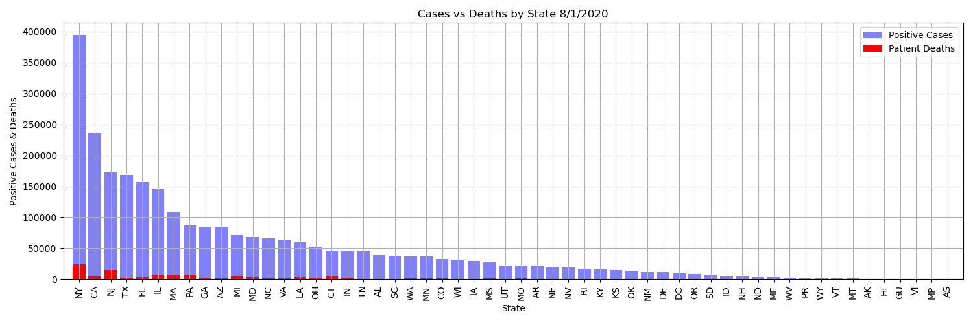
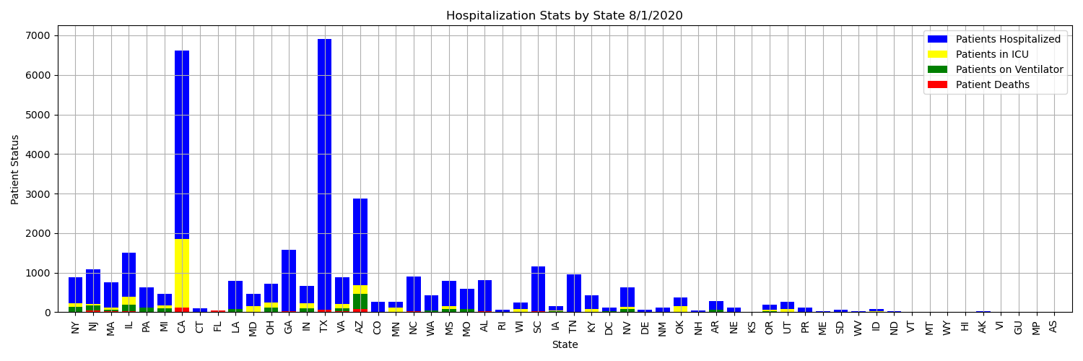
Notes:
Jump to August, which is right about when we see the Post July 4th numbers coming in, and CA, TX, IL, and GA (along with AZ) launch ahead of NY in number of patients hospitalized, and number of patients in the ICU as well.

Slide 14
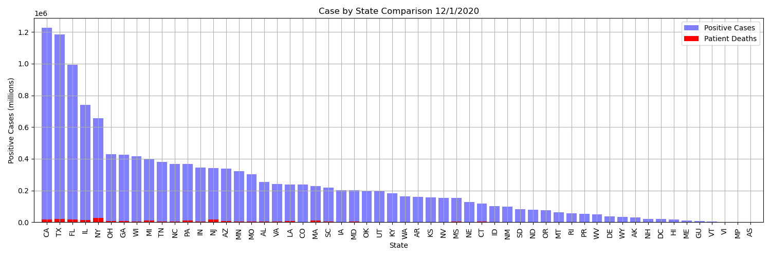
Notes:
Above is the initial case reading, below is the cases and deaths as of December 1st. CA, TX, FL, IL took the lead, followed by NY, OH, and GA. While NY still leads in total deaths, they seem to have slowed their case growth.

Slide 15
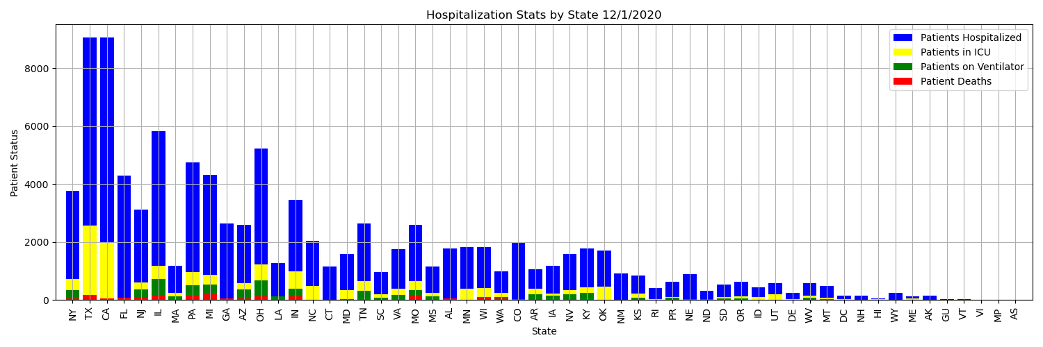
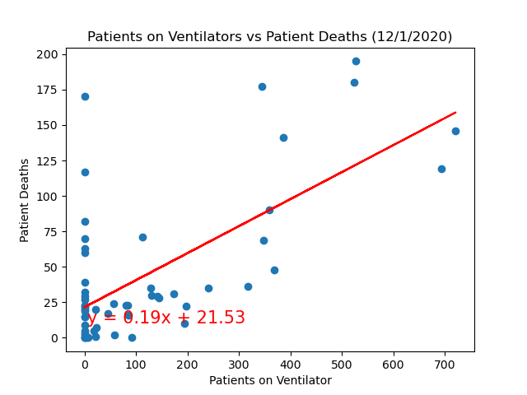
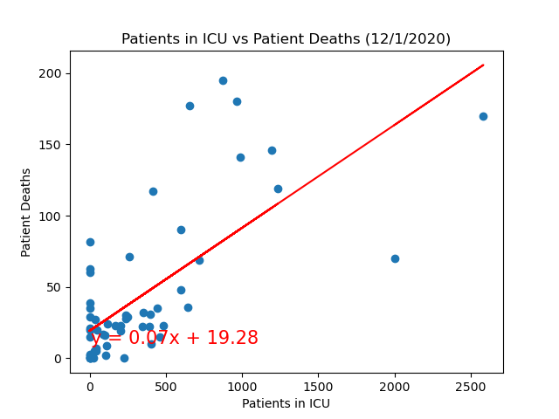
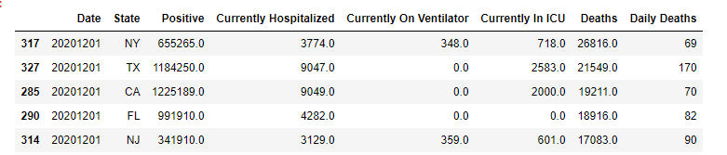
Notes:
Here’s a further breakdown, TX and CA lead in ICU patients, interestingly enough we don’t see much data in regards to people on ventilators (which is reflected in the scatterplot)
FL has finally joined the race with hospitalization rates, but IL and OH still ahead after CA and TX. (perhaps there’s a correlation with demographics and urban settings? -- would require further research)
The daily number of Patient Deaths vs. the Daily number of people in the ICU has a coefficient of determination of roughly 0.486… accounting for ~49% of the variance on the linear regression, and the Daily Patient deaths vs. Patients per Day in the ICU has a coefficient of determination of roughly 0.445… accounting for ~45% of the variance.

Slide 16
Covid Cases, Deaths- Age and Gender
Source Domain: data.cdc.gov, Created: 2/3/2021, 8:17:22 AM, Last Updated: 3/22/2021
“The Pandemic has finally opened our eyes to the fact that health is not driven just by biology, but by the social environment in which we all find ourselves and gender is a major part of that.”
Professor Sarah Hawkes
Co-Director of GH5050, in conversation with Common Thread

Slide 17
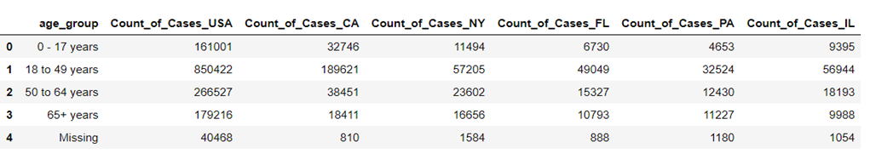
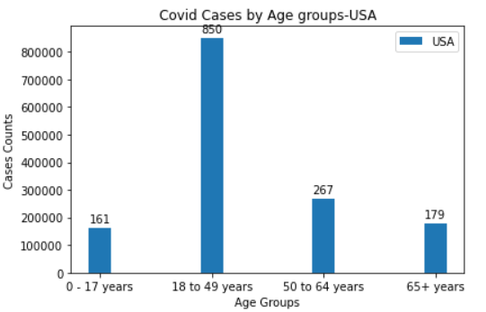
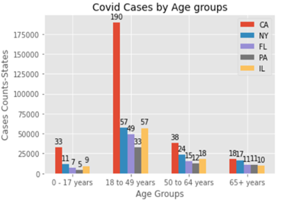
Covid Cases, Deaths- Age and Gender
Covid -19 Cases by Age

Slide 18
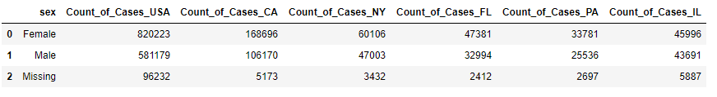
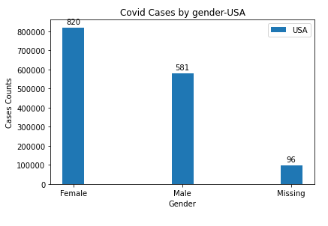
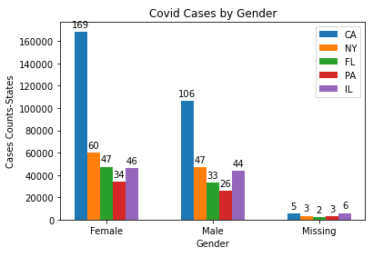
Covid Cases, Deaths- Age and Gender
Covid-19 Cases by Gender

Slide 19
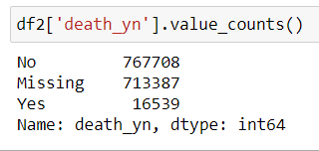
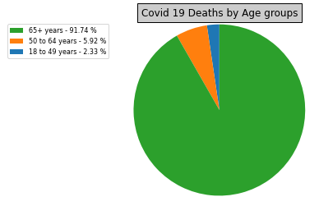

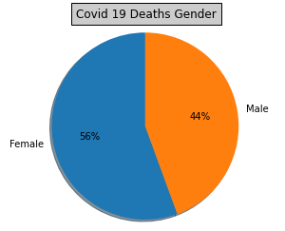
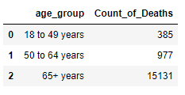
Covid Cases, Deaths- Age and Gender
Covid Deaths

Slide 20
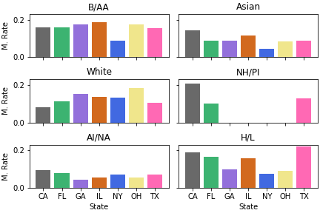
Mortality Rate in 7 “Top” COVID States by Demographic
B/AA = Black/ African American
NH/PI = Native Hawaiian/ Other Pacific Islander
AI/NA = American Indian/ Native Alaskan
H/L = Hispanic / Latino
Found by getting cumulative death count for each race demographic in each state then dividing by population of each race in each state and multiplying by 100
CDC data used for COVID death counts by demographic; Census API calls used for population data
Note: please do not get mad at me if an ethnicity on here is considered too general or worded incorrectly. I am just going off of what the Census and the CDC use.

Slide 21
Questions?

